Slide 1

Paper Presentation Template and Guideline
¹First Author, ²Second Author, and ³Last Author
¹Affiliation 1, ²Affiliation 2, ……..

Slide 2
Uploading Your Presentation
Bring an USB Drive with a copy of your presentation
Arrive at your session room at least 15 minutes early
Report to the Session Chair, and upload your presentation to the computer

Slide 3
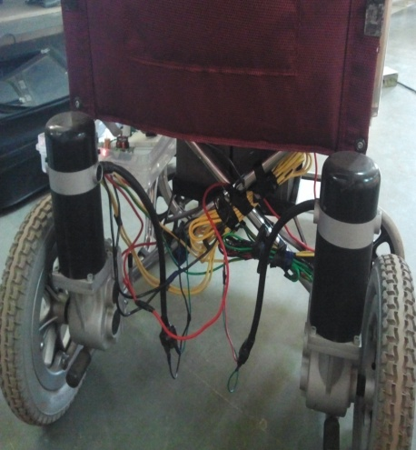
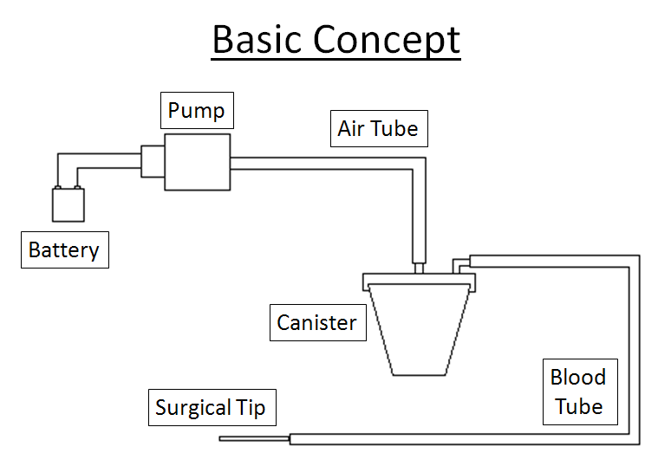
Sample of Good Figure and Photo

Slide 4
Recommended Text Style
Font
  Arial or Calibri. Both fonts have visually-simple characters and projects clearly. Use bold font style.
Font size
  36 to 44 point for titles, 36 point for sub-titles
  28 point for major bullets, 24 point for indented bullets
  Minimum 24 point for text on illustrations, graphs, figures, overlays on die photos
Density
  Keep the visual simple! It is better to use a large font and two slides than to use a small font in order to squeeze the message into one (unreadable) slide.

Slide 5
Recommended Outline Style
Background
Black text on white background is preferred.
Color
Use color sparingly overall, and only in schematics, graphs, illustrations, and photographs. Use color only when it enhances the clarity of the presentation. Bright red, blue, green and orange are easiest to see. Avoid yellows and light or pastel colors.
Line width
Use extra-wide line widths for colored lines. Use a minimum line width of 2-point for lines in drawings and schematics.

Slide 6

Presentation Time
Number of slides should be less than 15
It is important to stay within the allotted time of 15minutes.
Suggest to use 12 minutes for the presentation and 3 minutes for question and answer.
You should practice your presentation to ensure it is within 15 minutes.

Slide 7


Thank you
Please e-mail program.ghtc@ieee.org if you have any question.
For paper schedule:
  www.ieeeghtc.org/event/technical-program-2013
www.ieeeghtc.org

